Slide 1
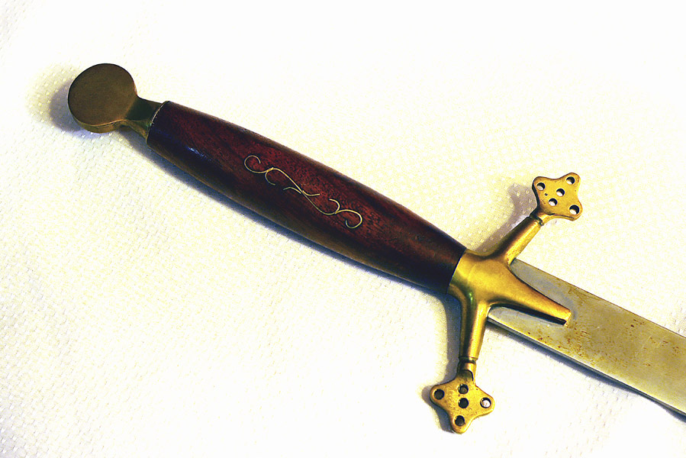
Thinking about Hamlet
An Interactive
Study Guide
Click the mouse to continue.
© 2010, www.ShakespeareHelp.com

Slide 2
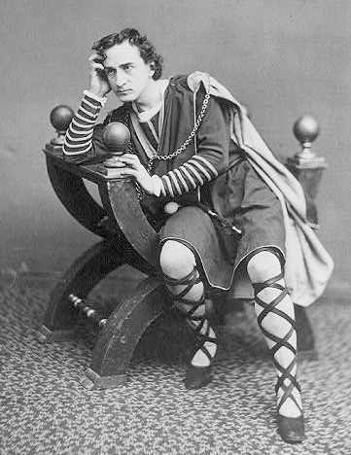
Hamlet – The Basics
Hamlet is the first of Shakespeare’s four great tragedies, written in 1600.
The other three are Othello (1601), King Lear (1606), and Macbeth (1606).
The plot of Hamlet is that of a “revenge tragedy,” a popular genre at this time.
The plot centres around a noble person who has been hideously wronged and must take revenge on a powerful enemy.
Hamlet’s delay and inaction is considered by many critics to be the central problem of the play.
Edwin Booth as Hamlet, 1870
Introduction
Next
Main Menu

Slide 3
The Great Chain of Being
God
Angels
Demons
Stars
Moons
Kings
Princes
Nobles
Men
Wild Animals
Domesticated Animals
Trees
Other Plants
Precious Stones
Precious Metals
Other minerals
Shakespeare’s audience believed in a great Chain of Being that determined the natural order of events.
The chain was a series of hierarchical links with God at the top.
Each level of the chain had its own hierarchy, with the king at the top of the human level.
Disruptions in the chain could also disrupt the laws of nature and cause bizarre events to occur.
Introduction
Back
Next
Main Menu

Slide 4
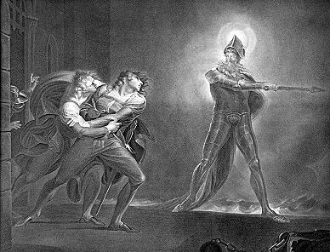
The Moral Climate of Hamlet
The King and the Chain of Being
The king was believed to have been appointed by God in order to assure the stability of society.
Removal of the king disrupted the chain of being and risked the collapse of order and universal disaster.
Ghosts and the Devil
Shakespeare’s audience believed in ghosts and believed that the ghost of a murdered person could return to demand revenge on his murderer.
Shakespeare’s audience also believed in the Devil and believed that he could appear on earth in many forms, including that of a ghost.
Hamlet and the Ghost, Henry Fuseli, 1789
Introduction
Back
Main Menu

Slide 5
Hamlet Quizzes
Act I
Act II
Act III
Act IV
Act V
Main Menu

Slide 6
Hamlet – Act I Quiz Click the hand  for an answer.
Why have Marcellus and Bernardo invited Horatio to join them on their watch? 
Who is Laertes, and what request does he make of the king?
How does Hamlet feel about his mother and why?
Briefly describe the murder of the king, as told to Hamlet by the ghost.
What are the ghost's instructions regarding the queen?
Hamlet Quizzes
Main Menu

Slide 7
Why have Marcellus and Bernardo invited Horatio to join them on their watch? Click anywhere to show answer.
Horatio has come to see for himself if the story they told him is true.
They claim that on the past two nights, at the stroke of one, a spirit has appeared in the likeness of the late King Hamlet.
Hamlet Quizzes
Next Question
Main Menu

Slide 8
Hamlet Quotes
Act I
Act II
Act III
Act IV
Act V
Main Menu

Slide 9
Hamlet – Act I Quotes Who said it, and what is he/she talking about? Click the hand  for an answer.
...Fear it, my dear sister, And keep you in the rear of your affection, Out of the shot of danger and desire. 
The serpent that did sting thy father's life Now wears his crown.
...meet it is I set it down That one may smile, and smile, and be a villain. At least I am sure it may be so in Denmark.
The time is out of joint: O cursed spite, That ever I was born to set it right!
Hamlet Quotes
Main Menu

Slide 10
...Fear it, my dear sister, And keep you in the rear of your affection, Out of the shot of danger and desire. Click anywhere to show answer.
Laertes is giving his sister Ophelia some brotherly advice before he returns to France. He tells her to view Hamlet's advances with caution in order to stay out of danger.
He believes Hamlet is sincere now, but because of his social position, may not be free to choose his bride. He warns Ophelia to consider what would happen if she "lost her honor" to Hamlet and was then rejected by him.
Hamlet Quotes
Next Question
Main Menu

Slide 11
Hamlet Characters
Hamlet
Gertrude
Claudius
Polonius
Ophelia
Laertes
The Ghost
Fortinbras
Two Clowns (gravediggers)
First Player
Horatio
Rosencrantz & Guildenstern
Player King and Queen
Minor Characters
Main Menu

Slide 12
Hamlet
Hamlet’s Madness
Hamlet’s Problem
Hamlet and Women
Hamlet’s Delay
Hamlet and His Mother
Hamlet and Oedipus
Characters
Main Menu

Slide 13
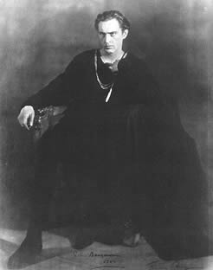
Hamlet’s Delay
Does Hamlet delay? There are two theories:
Hamlet does not delay. He acts as soon as he is convinced of Claudius’s guilt and the situation presents itself.
Hamlet does delay. He has several opportunities to kill the king before the final act, and he berates himself several times as a coward who is afraid to act.
After Hamlet hears the ghost’s story in Act I, he vows:
…that I, with wings as swift As meditation or the thoughts of love May sweep to my revenge. (I, 5)
John Barrymore as Hamlet, 1922
Characters
Hamlet
Next
Main Menu

Slide 14
Hamlet’s Delay - 2
In Act III, Hamlet reacts strongly to the player’s performance of Queen Hecuba’s grief for her murdered husband.
He compares the player’s theatrical grief to his own situation.
O, vengeance! / Why, what an ass am I! (II, 2)
However, after this scene, Hamlet further delays by deciding to find out whether the ghost was telling the truth about the murder, for the first time expressing doubts about the ghost’s story.
Is this a real concern or another delaying tactic?
In his “To be or not to be” soliloquy, Hamlet gives another reason for his delay: his own conscience.
Thus conscience does make cowards of us all; And thus the native hue of resolution Is sicklied o'er with the pale cast of thought… (III, 1)
Characters
Hamlet
Next
Back
Main Menu

Slide 15
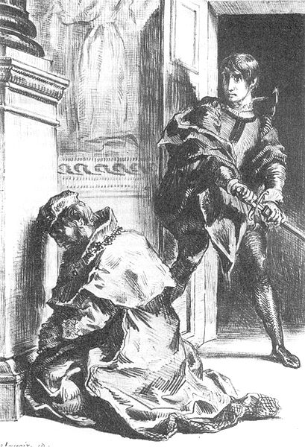
Hamlet’s Delay - 3
In III, 3, Hamlet finally has a “golden opportunity” to kill Claudius while he is praying.
He is convinced of Claudius’s guilt, and his mood is “murderous.”
However, he chooses not to act, afraid that Claudius’s soul will go to Heaven, and decides to wait until he can catch him in a sinful act.
Is Hamlet rationalizing another delay, or is this a legitimate reason?
One of the worst aspects of Claudius’s crime is that King Hamlet was killed with no chance to repent his earthly sins.
Contrast Hamlet’s behavior in this scene to his impulsive murder of Polonius in the next scene.
Claudius at Prayer, Eugene Delacroix, 1844
Characters
Hamlet
Next
Back
Main Menu

Slide 16
Hamlet’s Delay - 4
In IV, 4, Hamlet speaks to a Norwegian captain in the service of Fortinbras, who is fighting for a small patch of land held by the Poles.
Hamlet compares himself to Fortinbras, who will expose himself to “death and danger…even for an egg-shell.”
He berates himself again for not acting and “thinking too precisely on the event.”
Hamlet ends his last soliloquy, vowing:
O, from this time forth, My thoughts be bloody, or be nothing worth!
When Hamlet duals Laertes in the final scene, he finally kills Claudius and accomplishes his revenge.
Hamlet has no “plan” going into the final scene.
When he finally kills the king after Laertes reveals that Claudius poisoned his weapon, he acts quickly without thinking (perhaps reacting emotionally to the death of his mother?).
Characters
Hamlet
Back
Main Menu

Slide 17
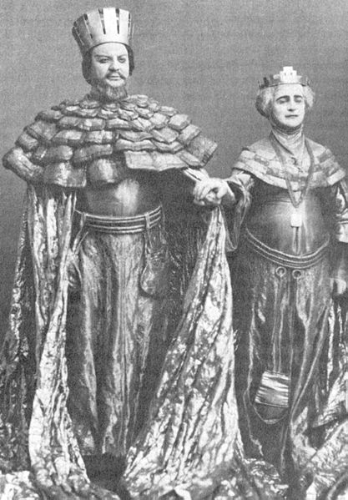
Claudius
Claudius is a symbol of evil.
He is guilty of killing the king, his own brother.
He coldly plans the murder of Hamlet.
He is willing to sacrifice both Laertes and Gertrude to avoid being discovered.
Claudius’s main goal is to maintain his own power.
He manipulates everyone in the play—Gertrude, Ophelia, Polonius, Laertes, and Rosencrantz and Guildenstern.
Although a villain, Shakespeare makes Claudius human by revealing that he has a conscience when he tries to pray.
Russian actors Nikolai Massalitinov and Olga Knipper (wife of Anton Chekhov) as Claudius and Gertrude in Stanislavski's Hamlet (1911)
Characters
Next
Main Menu

Slide 18
Claudius - 2
As a shrewd and conniving man of action, Claudius is one of the foils to Hamlet in the play.
Claudius does not hesitate to act, and he is not bothered by moral doubts.
When Claudius learns of Polonius’s murder, he concerned for his own safety, not Gertrude’s:
O heavy deed! It had been so with us, had we been there: His liberty is full of threats to all—
Claudius is ultimately undone by his own plan.
Instead of relying on Laertes’s poison sword, he poisons the drink as a backup plan.
When Gertrude drinks the poison and dies, Hamlet is finally motivated to kill Claudius.
Characters
Back
Main Menu

Slide 19
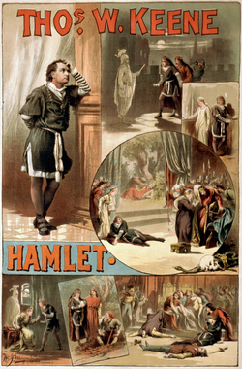
Themes and Motifs in Hamlet
Acting
Madness
Ears
Corruption / Decay
Reason vs. Passion
Revenge
Spying
Suicide / Death
Thos. Keene in Hamlet, 1884
Main Menu

Slide 20
Spying
There are multiple instances of spying or eavesdropping in Hamlet.
These scenes contribute to the overall atmosphere of suspicion, mistrust and uncertainty in the play.
III, 1: Claudius and Polonius spy on Hamlet and Ophelia.
Hamlet is probably aware that they are eavesdropping and performs for their benefit, although some of his conversation with Ophelia seems sincere.
II, 1: Polonius sends Reynaldo to spy on Laertes in order to discover information about his reputation.
Polonius even instructs him to slander Laertes in order to see if his insults are confirmed or denied by others:
See you now; Your bait of falsehood takes this carp of truth: And thus do we of wisdom and of reach, With windlasses and with assays of bias, By indirections find directions out. (II, 1)
Themes and Motifs
Next
Main Menu

Slide 21
Spying - 2
Claudius sends for Rosencrantz and Guildenstern to hang out with Hamlet and try to find out what “afflicts” him:
…so by your companies To draw him on to pleasures, and to gather, So much as from occasion you may glean, Whether aught, to us unknown, afflicts him thus. (Claudius, II, 2)
Claudius is being sneaky here. He wants to find out through Rosencrantz and Guildenstern how much Hamlet knows.
Hamlet knows they are Claudius’s stooges, and mocks them viciously:
ROSENCRANTZ : Take you me for a sponge, my lord?
HAMLET : Ay, sir, that soaks up the king's countenance, his rewards, his authorities…when he needs what you have gleaned, it is but squeezing you, and, sponge, you shall be dry again. (IV, 2)
Themes and Motifs
Next
Back
Main Menu

Slide 22
Spying - 3
Polonius eavesdrops on Hamlet and Gertrude while hiding behind an arras, and is killed by Hamlet.
It is ironic that Polonius, who advocates eavesdropping to Claudius and sends an agent to spy on his own son, is killed because of his own deception.
The play-within-the-play is one of the best examples of spying on others in the play.
Hamlet devises the plan in order to observe Claudius’s behavior:
I have heard / That guilty creatures sitting at a play Have …been struck so to the soul that presently They have proclaim'd their malefactions; (II, 2)
While Hamlet and the audience watch Claudius during the play for signs of guilt, we (the audience) are also watching Hamlet watching Claudius.
Themes and Motifs
Back
Main Menu

Slide 23
YouTube Videos
Links to YouTube videos are not available in the preview version of this presentation.
To purchase, visit www.ShakespeareHelp.com.
Main Menu

Slide 24
Essay Topics
Essay topics are not available in the preview version of this presentation.
To purchase, visit www.ShakespeareHelp.com.
Main Menu

